Slide 1



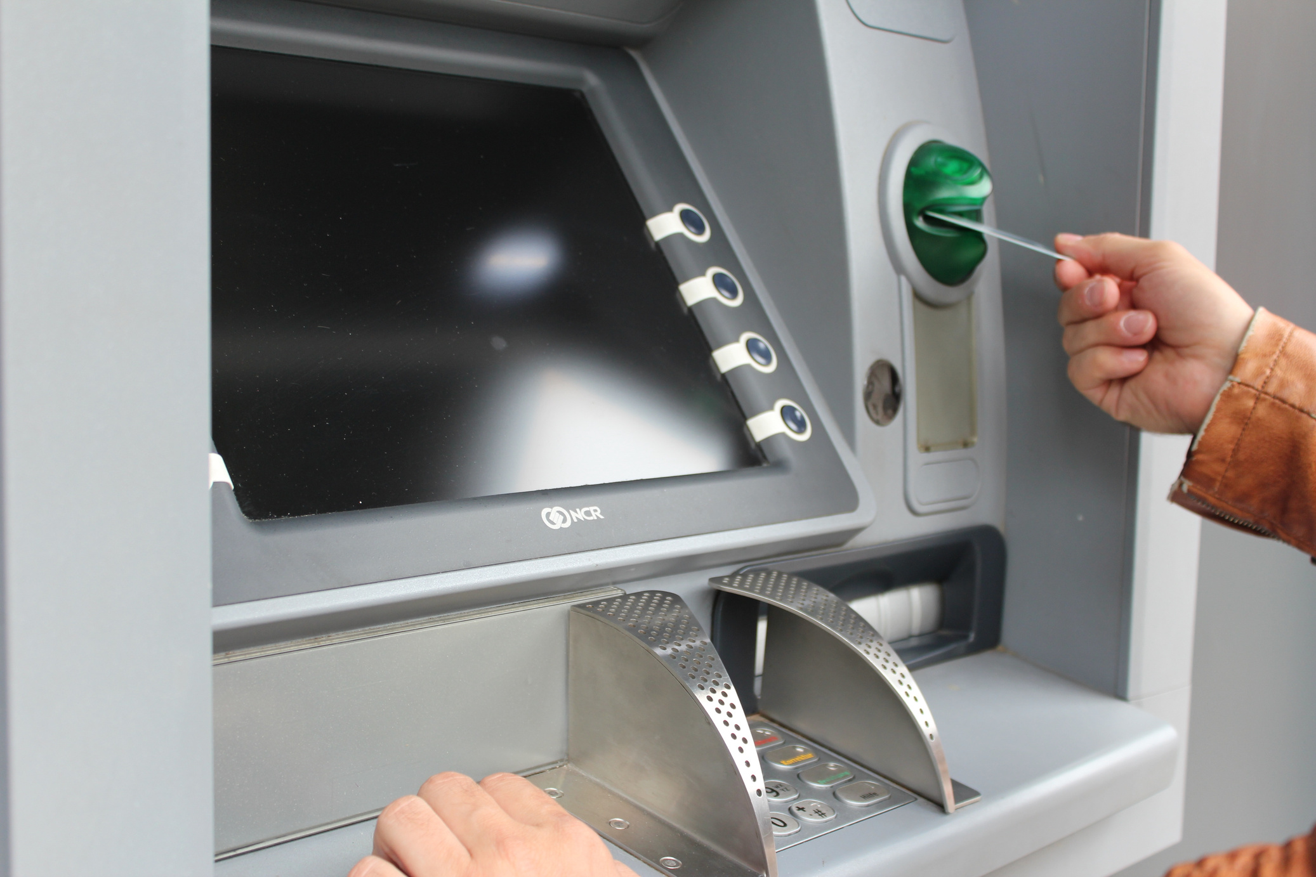


Sl
A mini Project on
Under the Guidance Of
Mr. Gaurav Narain Singh
(Assistant Professor C.S.E)
ATM SIMULATOR SYSTEM
Created By:
Sneha Patel
Anchal Dwivedi
Prashasti Jaiswal
Himanshi Vishwakarma

Slide 2

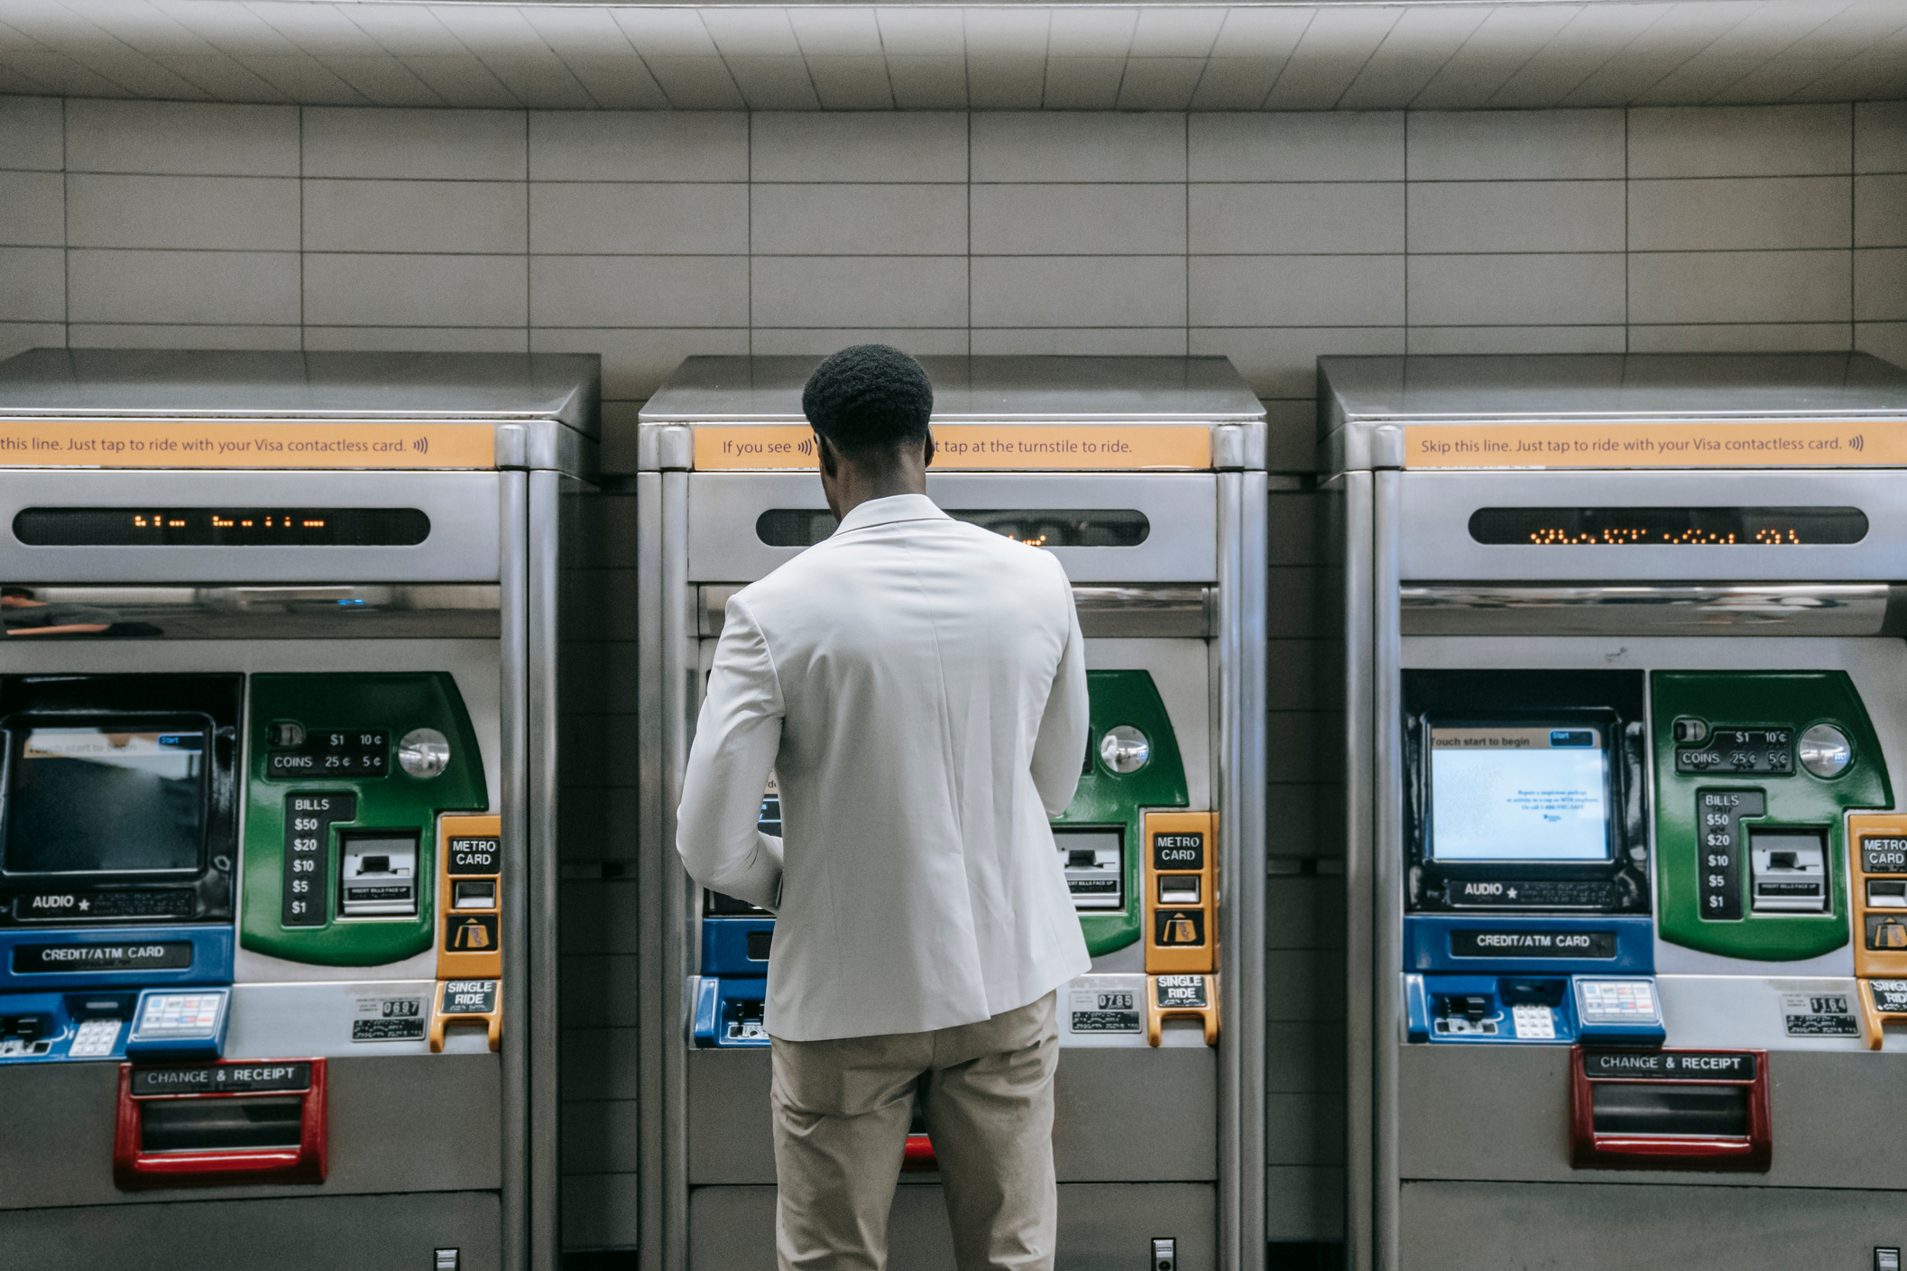

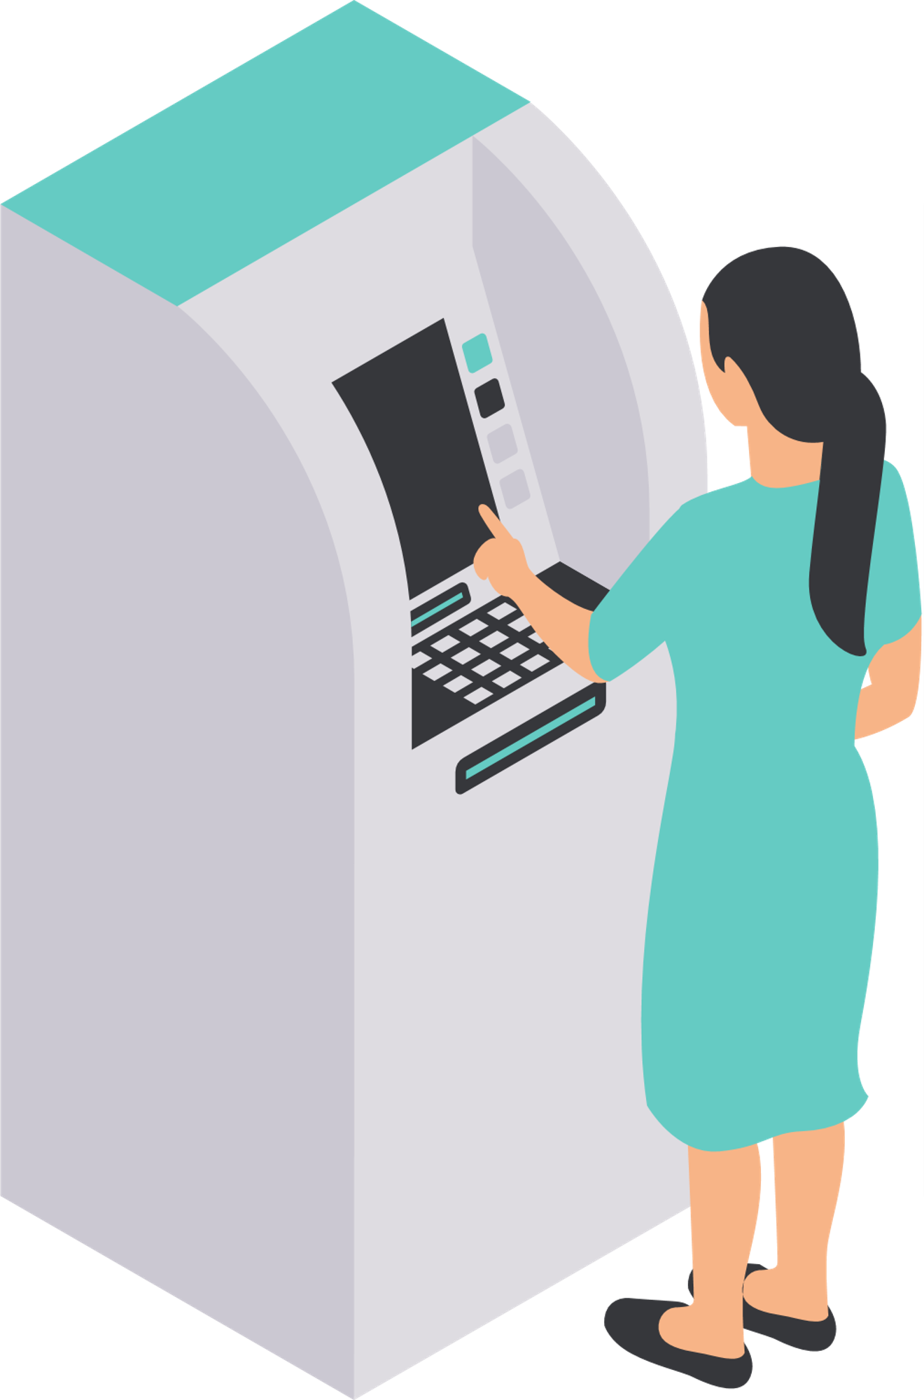
TABLE
of contents
Introduction
Project Overview
Technology Used
Database connectivity
Code snippet
Future scope
Conclusion

Slide 3
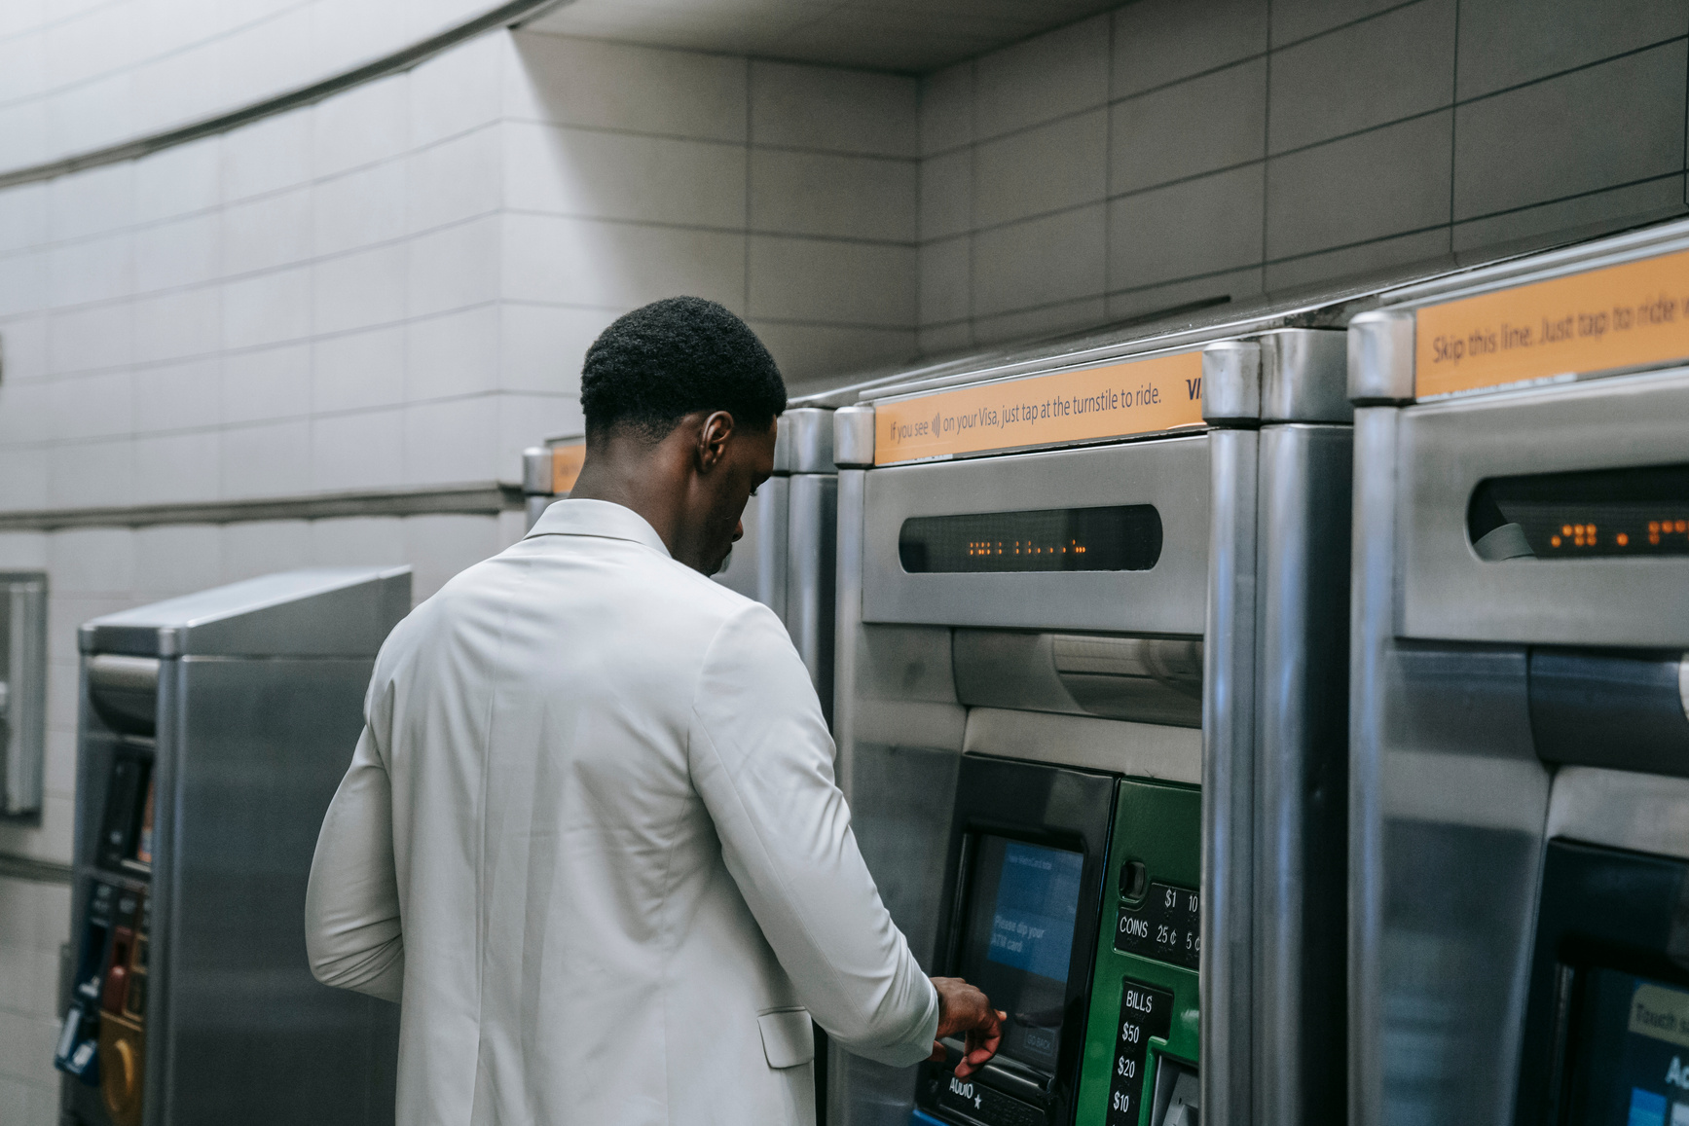
INTRODUCTION
The ATM Simulator System lets users complete tasks including checking their account balance, taking cash out, depositing money, and reviewing transaction history through simulating the fundamental features of an Automated Teller Machine (ATM). With the help of this technology, consumers may interact with a virtual ATM that accurately simulates real-world financial scenarios.

Slide 4
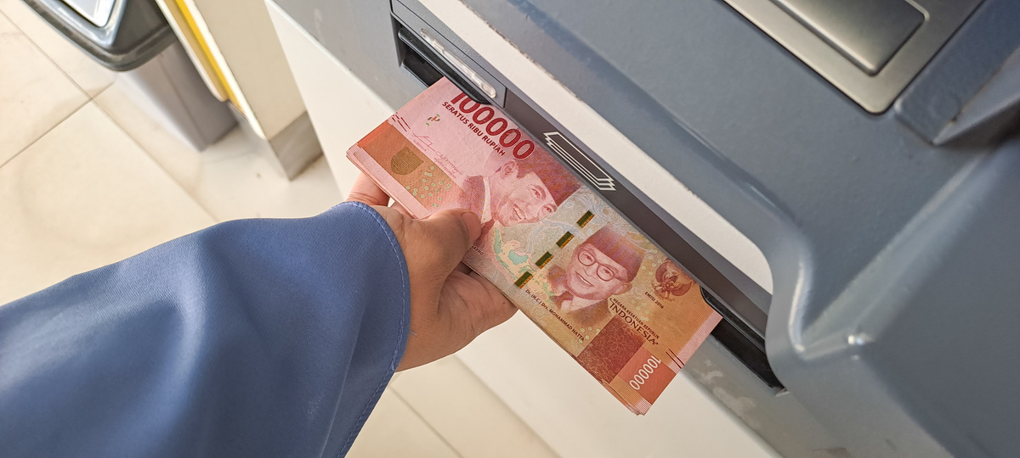
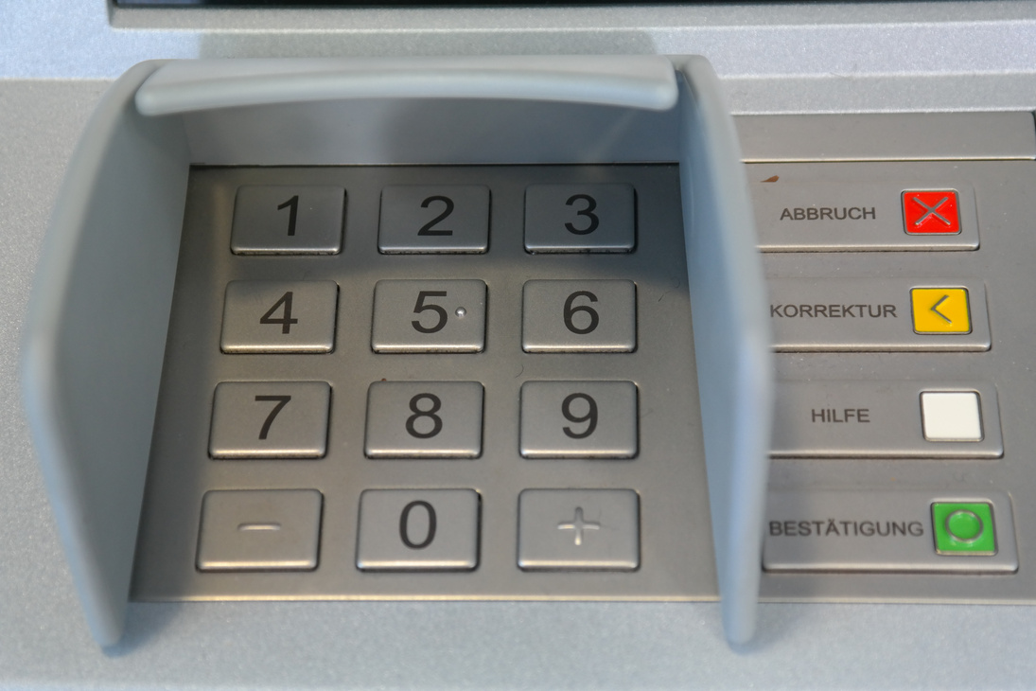
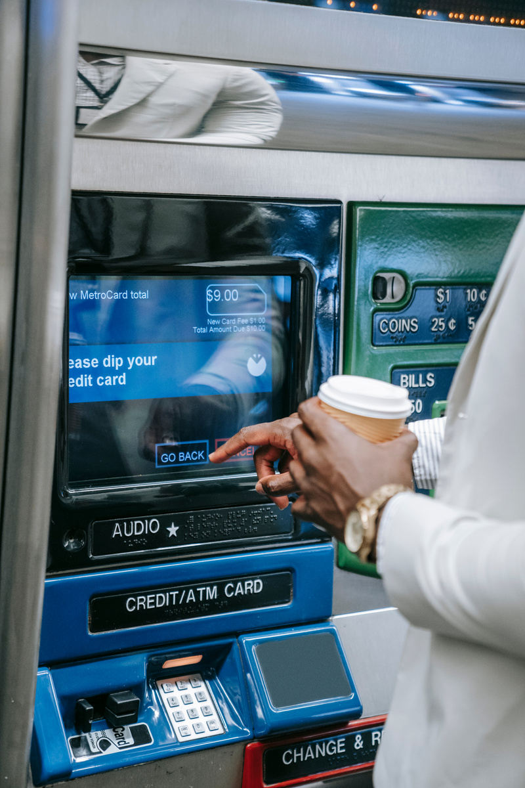
PROJECT OVERVIEW
The goal of the ATM Simulator System project is to offer a user-friendly interface so that users can replicate typical ATM functions.
This mini-project offers real-time feedback on user actions, links with databases for account management, and aids in gaining knowledge of banking transaction procedures.
The mini-project can be used as a teaching aid for understanding database management and transaction flows in financial systems.
Key Features:
- User Authentication (PIN validation)
- Balance Inquiry - Cash Withdrawal
- Cash Deposit -Exit

Slide 5

TECHNOLOGIES USED
DATABASE CONNECTIVITY
DEVELOPMENT ENVIRONMENT
Hardware Used
FRONTEND
BACKEND
RAM- atleast 100Mb
Hard Disk- min. 500Mb
Processor-min P4
Oracle XE 10g Database (for user data storage)
& JAVA
JDBC (Java Database Connectivity) to interact with SQL
Java Swing/AWT
(for graphical user interface)
IntelliJ IDEA

Slide 6

USER INTERFACE
JAVA SWING AND AWT WAS USED IN THE DESIGN OF THE USER INTERFACE, GIVING IT A GRAPHICAL LAYOUT . FUNCTIONALITIES PERFORMED BY THE USER :-
LOGIN SCREEN
MAIN MENU
TRANSACTION SCREENS
Options to make deposits, withdraw money, and check balance.
for user authentication and PIN entry.
For depositing money, withdrawing cash, and displaying the findings of balance queries.

Slide 7


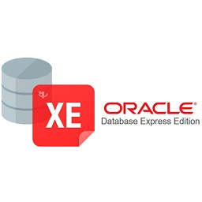
DATABASE CONNECTIVITY
THE JAVA APPLICATION AND SQL DATABASE ARE CONNECTED BY THE SYSTEM USING JDBC .
DATABASE STRUCTURE IN SQL
USERS TABLE: HOLDS BALANCE, PIN, AND CARD NUMBERS
TRANSACTIONS TABLE: KEEPS TRACK OF ALL USER TRANSACTIONS (DEPOSITS AND WITHDRAWALS).

Slide 8
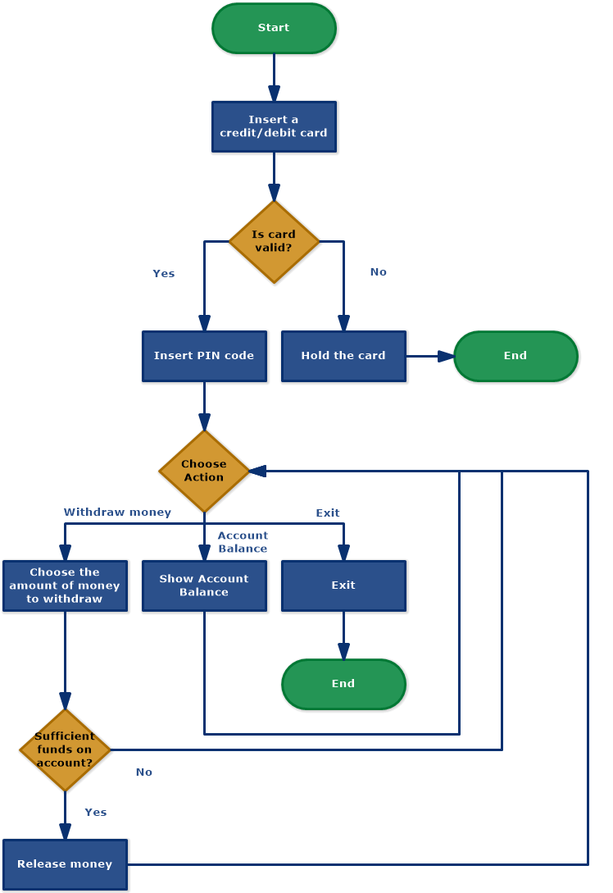
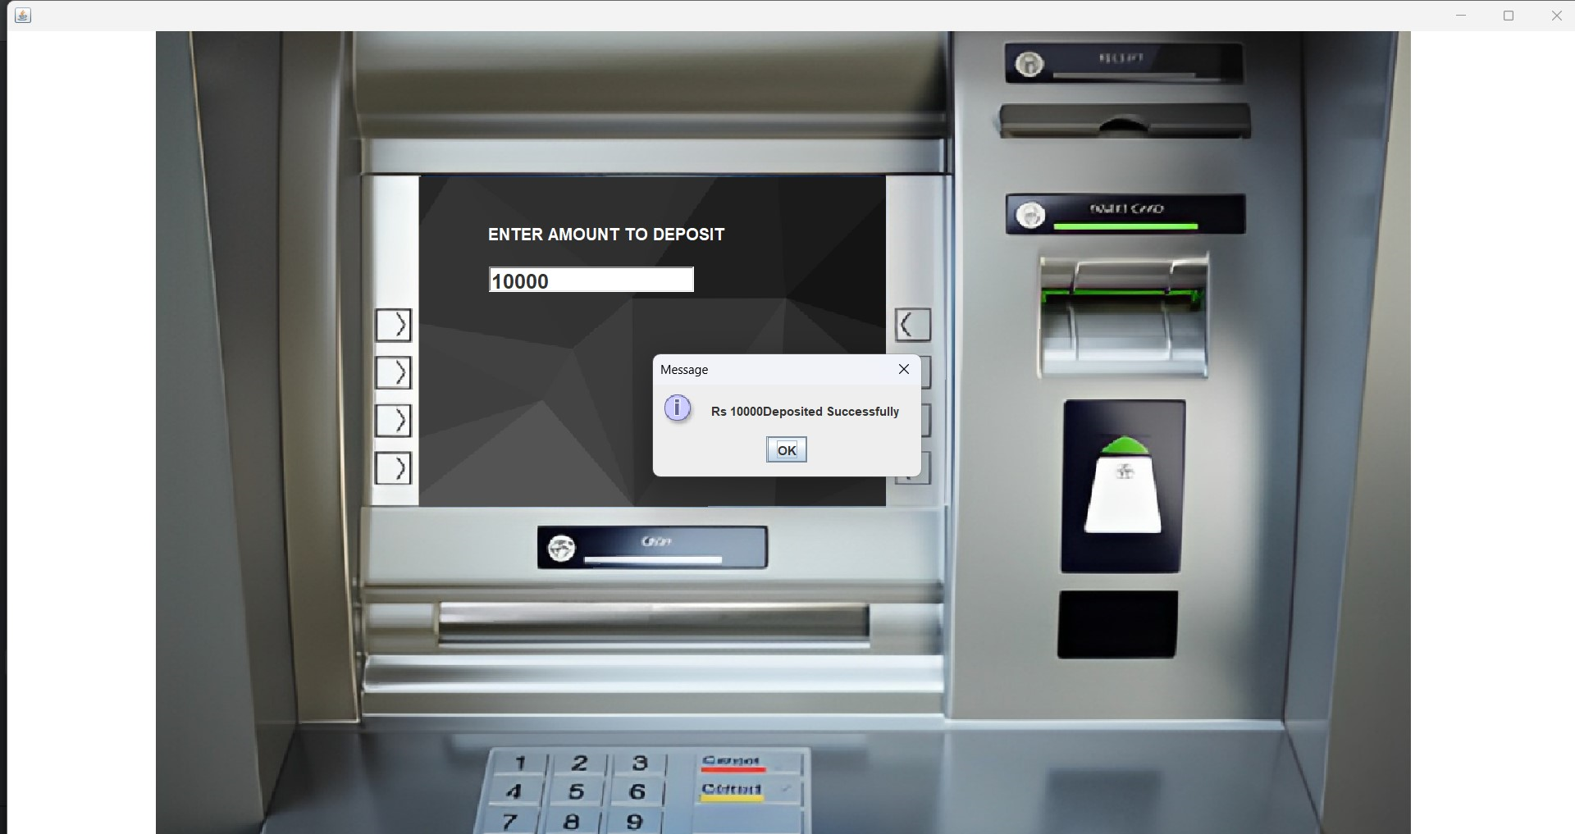
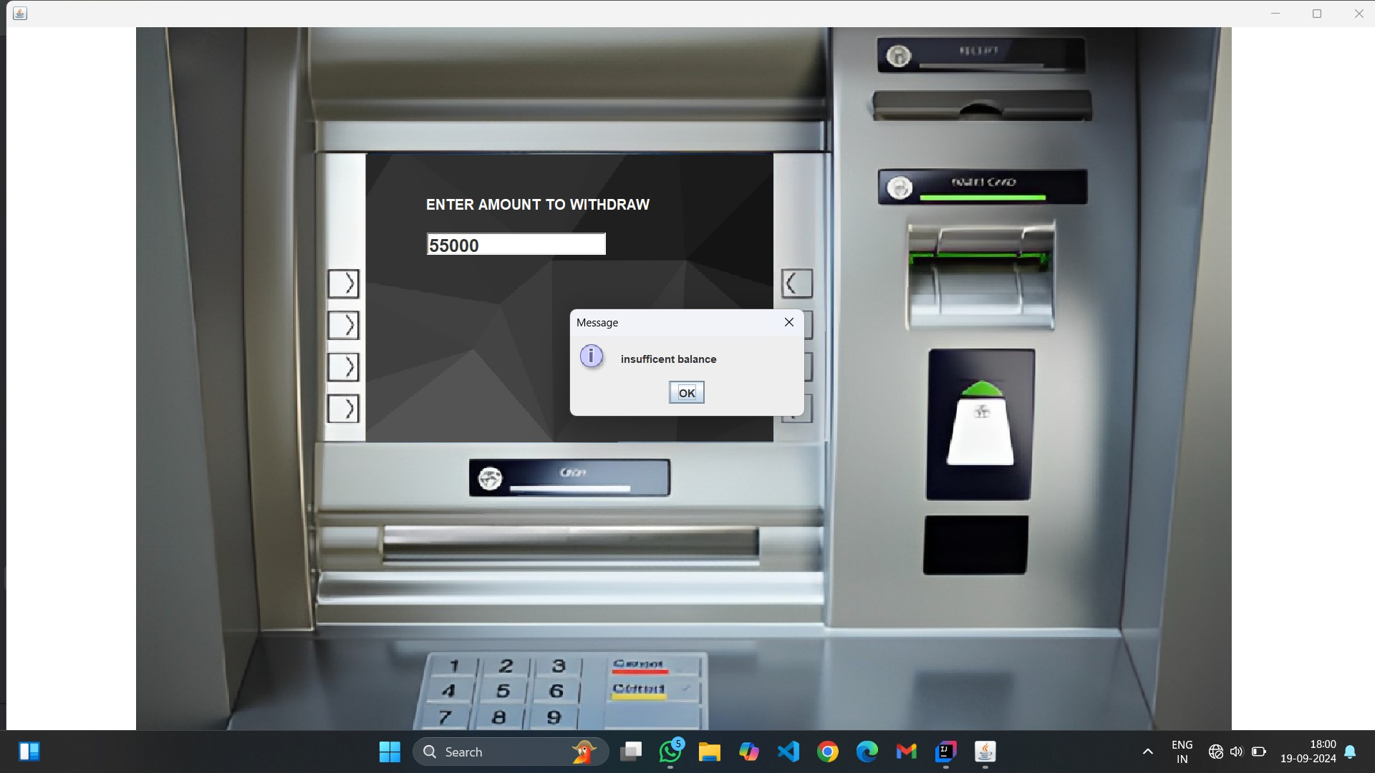
FLOWCHART

Slide 9
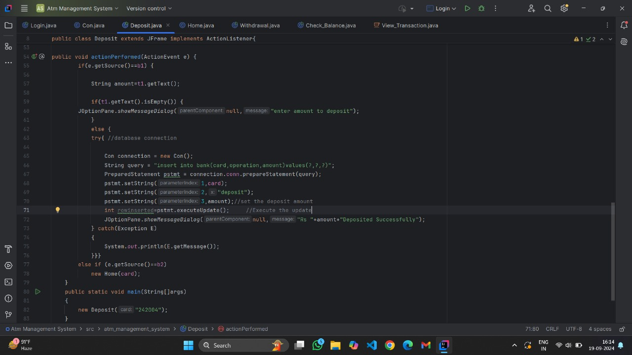
CODE SNIPPET
Below is an example of the code for the cash withdrawal process:
```java
public void withdrawCash(int accountNumber, double amount) {
Connection con = DriverManager.getConnection("jdbc:mysql://localhost:3306/atm_simulator", "root", "password");
// Fetch current balance
String query = "SELECT balance FROM users WHERE account_number = ?";
PreparedStatement pstmt = con.prepareStatement(query);
pstmt.setInt(1, accountNumber);
ResultSet rs = pstmt.executeQuery();

Slide 10
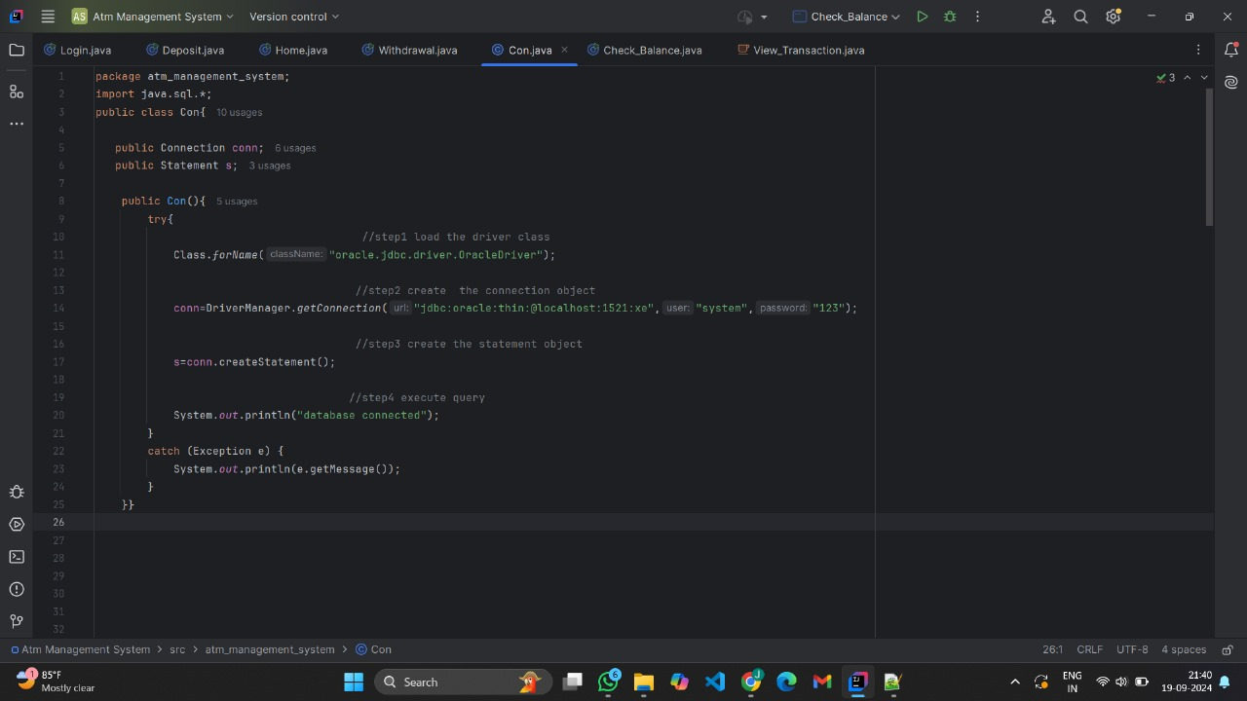
CODE SNIPPET
CODE
IF (RS.NEXT()) {
double balance = rs.getDouble("balance");
if (balance >= amount) {
// Deduct amount
String updateQuery = "UPDATE users SET balance = balance - ? WHERE account_number = ?";
pstmt = con.prepareStatement(updateQuery);
pstmt.setDouble(1, amount);
pstmt.setInt(2, accountNumber);
pstmt.executeUpdate();
System.out.println("Withdrawal Successful!");
} else {
System.out.println("Insufficient balance!");
}
}
}

Slide 11
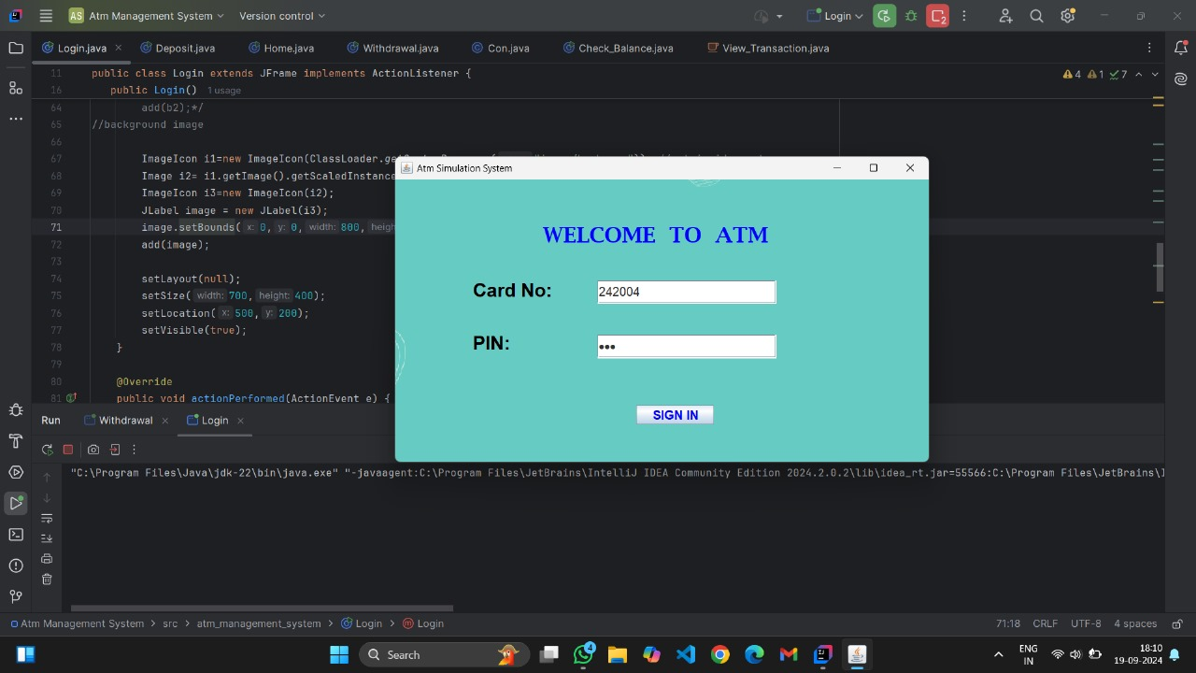

Slide 12
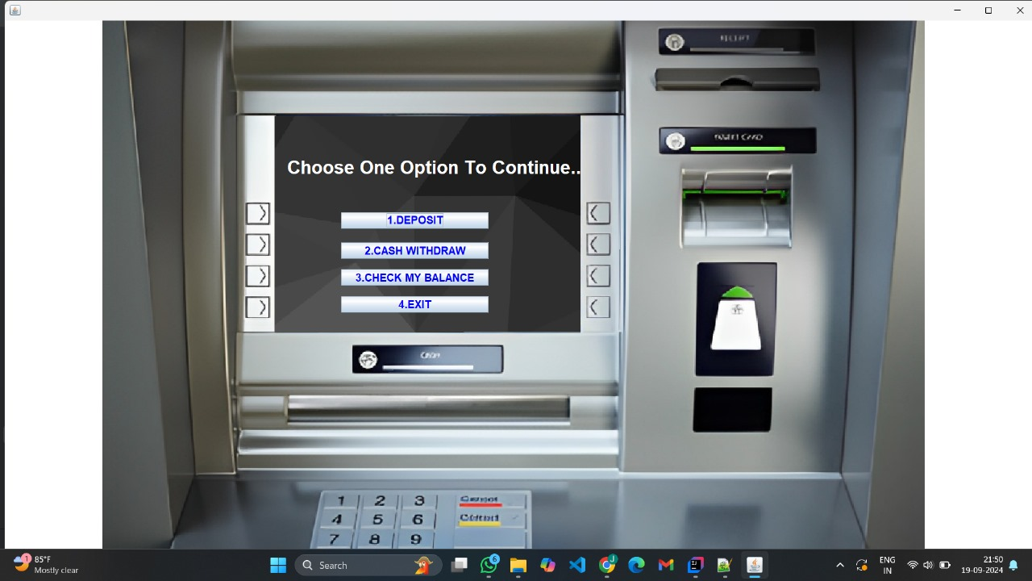

Slide 13
FUTURE SCOPE
- AI Chatbots:
Provide an ATM driven Virtual assistant to provide users through ATM functionalities.
- Support for multiple accounts and users:
Expanding the system to support multiple users with different accounts, such as saving accounts
- Transaction History:
enabling users to wheel their past transactions download receipts Enhancing user experience.
- Logout Timer: Log out user if there is no Activity for a specific. This will improve security and prevent unauthorized access.
- Mobile Integration: Adding functionality to the system to enable mobile apps.

Slide 14

CONCLUSION
An instructional tool that helps mimic actual ATM operations and provides insight into how users interact with financial systems is the ATM Simulator System. It offers a useful method for comprehending transactional flows and database administration, with room for improvements in areas like mobile integration and security.

Slide 15
THANK YOU

